Slide 1

COM 316: Artificial intelligence and Expert systems
Lecture Notes
Natural Language Processing
COM 316: Dr. T Njoroge

Slide 2
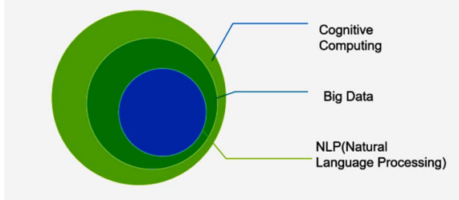
Natural language processing (NLP)
Natural language processing (NLP) is a core ability of cognitive computing systems
It is the technology concerned with programing computers to process and analyze data so that they can generate or understand human language.
COM 316: Dr. T Njoroge

Slide 3

Challenges of NLP
1. Language is specifically constructed to convey the speaker/writer's meaning. This is a complex task, although little children can learn it pretty quickly.
2. Human language is extremely dynamic. The meaning of words changes subtly over time, and new words are constantly introduced into use. This means that NLP models must follow word trends, and understand how those tie into concepts and messages.
COM 316: Dr. T Njoroge

Slide 4
Challenges of NLP
3. Ambiguity of human language makes understanding to be difficult. For example, there is an infinite number of different ways to arrange words in a sentence. Also, words can have several meanings and contextual information is necessary to correctly interpret sentences.
Three types of human language Ambiguity
  Lexical Ambiguity
  Syntactical Ambiguity
  Referential Ambiguity
COM 316: Dr. T Njoroge

Slide 5
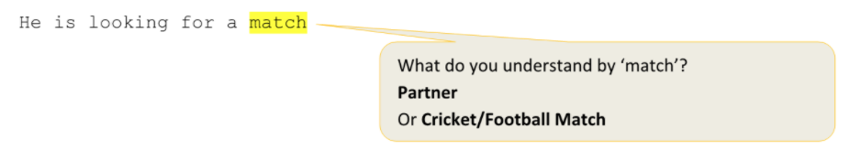
i. Lexical Ambiguity
Lexical Ambiguity can occur when a word carries different sense,
i.e. having more than one meaning and the sentence in which it is contained can be interpreted differently depending on its correct sense.
COM 316: Dr. T Njoroge

Slide 6
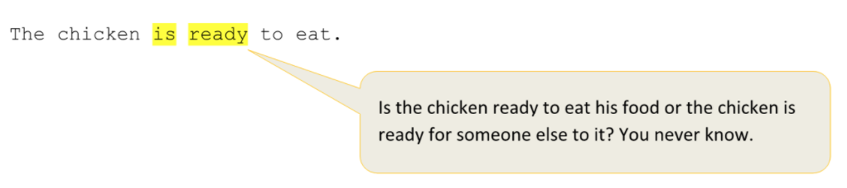
ii. Syntactical Ambiguity
Syntactical Ambiguity occurs when a sequence of words have more than one meaning . It is also termed as grammatical ambiguity.
Example
COM 316: Dr. T Njoroge

Slide 7
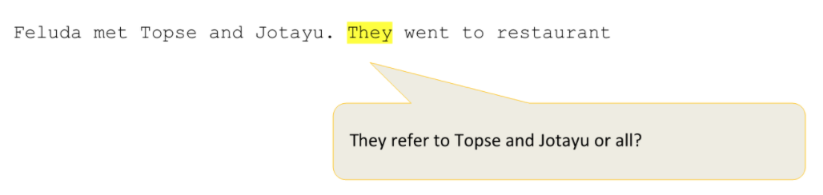
iii. Referential Ambiguity
Referential Ambiguity occurs when the same entity( e.g. a person or an object) is mentioned more than once in the same text but using different word.
The Pronoun (e.g. They) causes ambiguity when it is not clear which noun it is referring to
COM 316: Dr. T Njoroge

Slide 8
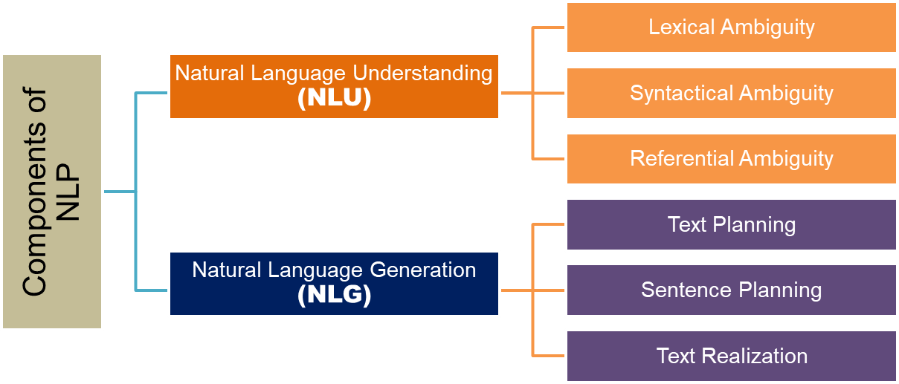
Components of Natural language processing
There are two main branches of Natural language processing
COM 316: Dr. T Njoroge

Slide 9
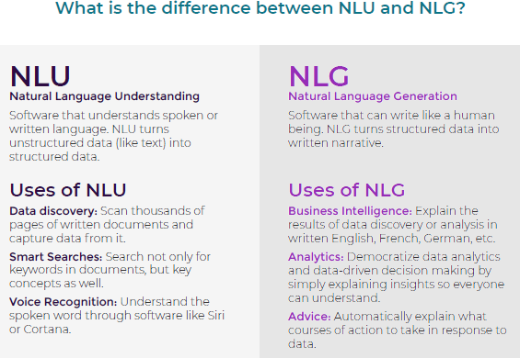
Components of Natural language processing
COM 316: Dr. T Njoroge

Slide 10
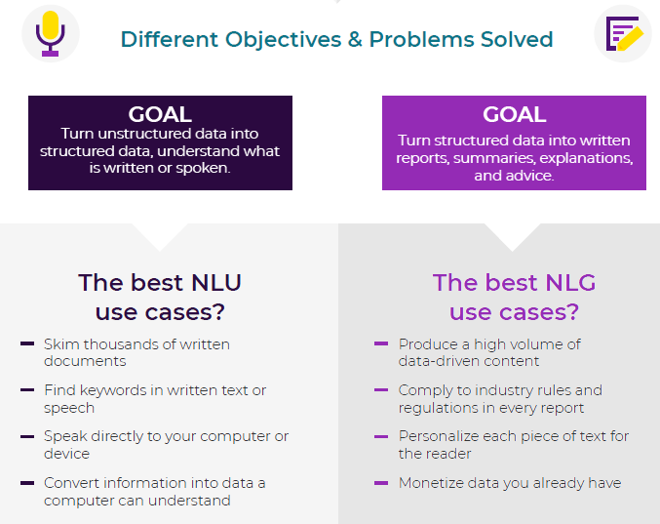
Components of Natural language processing
NLU
NLG
COM 316: Dr. T Njoroge

Slide 11
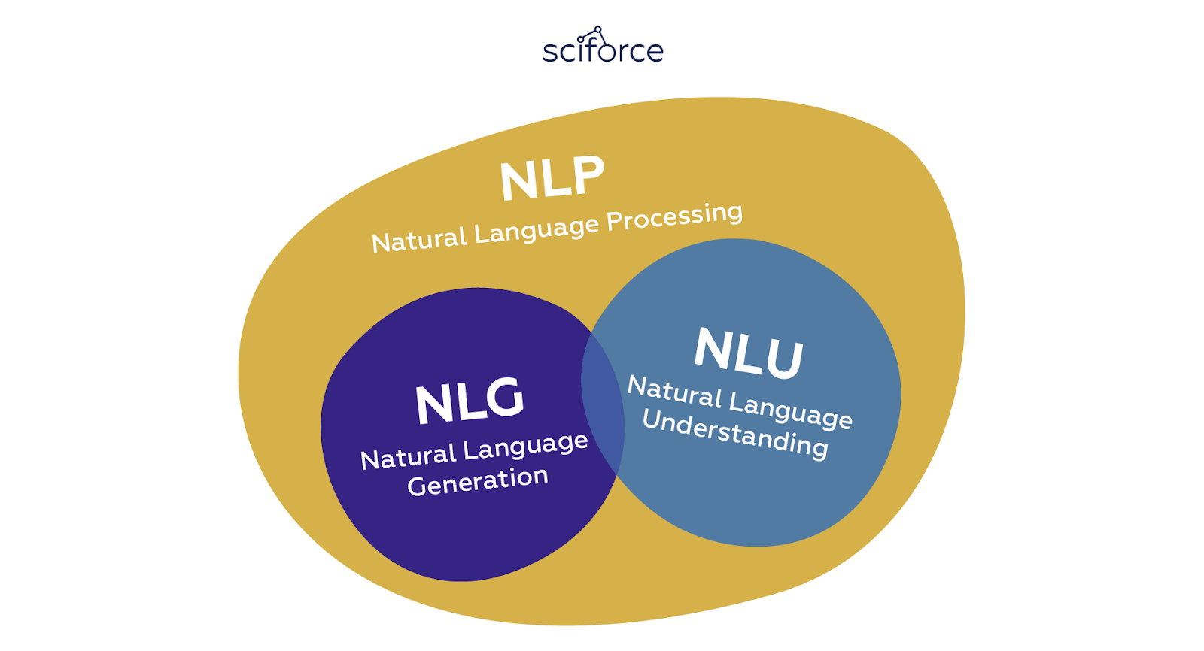
Components of Natural language processing
The two components of NLP share some of the NLP techniques
COM 316: Dr. T Njoroge

Slide 12
Components of NLP
Natural Language Generation
COM 316: Dr. T Njoroge

Slide 13
Natural language Generation
Natural language generation is the process of producing meaningful phrases and sentences in the form of natural language from some internal representation.
NLG systems are able to summarize larger amounts of data and generate reports that explain WHY numbers are what they are.
Such systems can automatically turn numbers in a spreadsheet into data-driven narratives or even use associations between words to create partially or fully machine-written text.
https://www.kdnuggets.com/2020/01/guide-natural-language-generation.html
COM 316: Dr. T Njoroge
https://devopedia.org/natural-language-generation

Slide 14
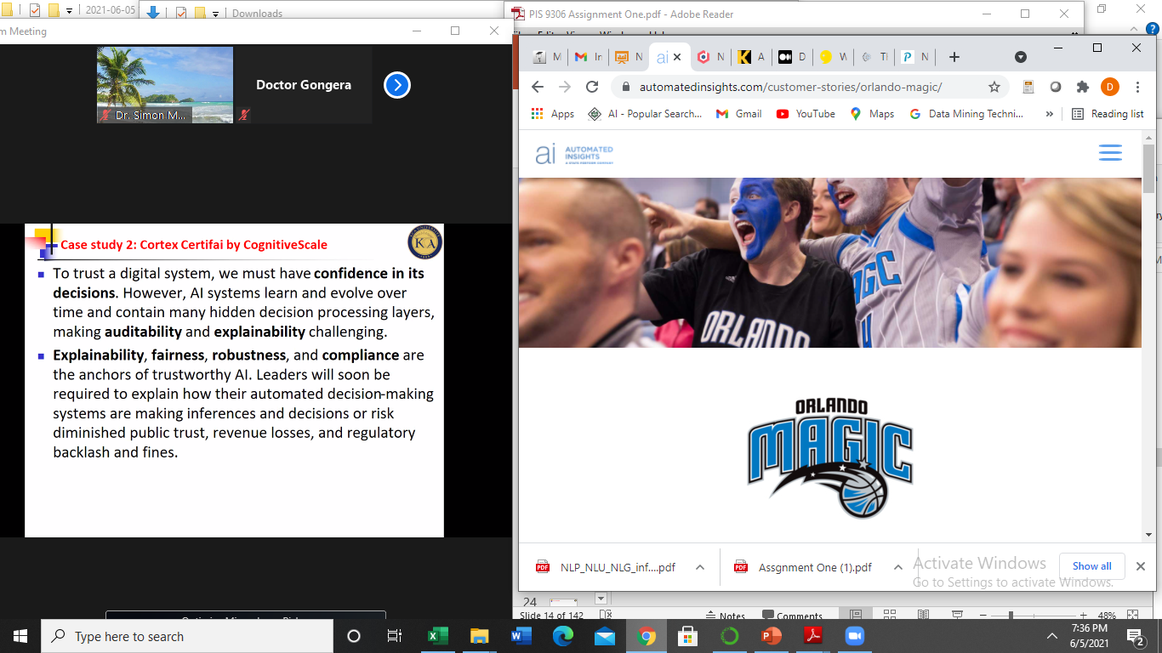
Benefits of NLG
1. Extensive Personalization at Scale: NLG enables to generate complex personalization at scale, creating improved customer communication and experience with your organization.
For example, A financial services firm, can deliver portfolio summaries to thousands of clients with each summary using the customer’s unique set of information to speak directly to the individual.
Case study: the Orlando Magic improved communication for their loyalty ticketing program using NLG.
Url: https://automatedinsights.com/customer-stories/orlando-magic/
COM 316: Dr. T Njoroge

Slide 15
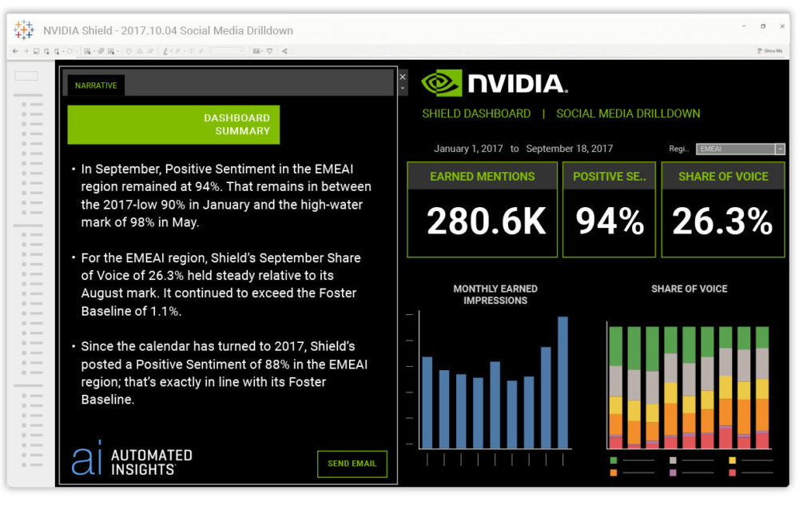
Benefits of NLG
NLG Make Data Understandable and Insightful by automating the “translation” process that occurs when experts need to explain their findings in clear, concise ways to clients or to others within their organization who may not be data experts.
NLG conveys expert-level analysis and advice in concise, insightful terms that engage and fully inform each reader-regardless of data expertise.
An example of NLG used in a BI dashboard to provide a narrative summary.
https://automatedinsights.com/blog/the-ultimate-guide-to-natural-language-generation/
COM 316: Dr. T Njoroge

Slide 16
Benefits of NLG
Speed and Scale of Content Creation
With NLG, we can produce thousands of unique narratives in a fraction of the time it would take to write them manually
For example, the process of writing hundreds or thousands of product descriptions is time-consuming and costly-whether that’s stealing valuable time from in-house writers or hiring an army of freelancers to complete the task.
With NLG, the inventory specifications for each unique product in a catalog can be transformed into a unique, keyword-rich description.
COM 316: Dr. T Njoroge

Slide 17
Natural language Generation Tasks
NLG tasks can be divided into three categories,
1. Text-to-text (text-to-text), such as translation, summaries,
2. Text to other (text-to-other), such as text generated pictures
3. Other-to- text, such as video text generation.
COM 316: Dr. T Njoroge

Slide 18
Natural language Generation Techniques
NLG Techniques includes the following:
1. Recurrent Neural Network (RNN)
2. Short and long term memory (LSTM)
3. Transformer.
4. Markov chain algorithm
https://programmersought.com/article/28633109826/
COM 316: Dr. T Njoroge

Slide 19
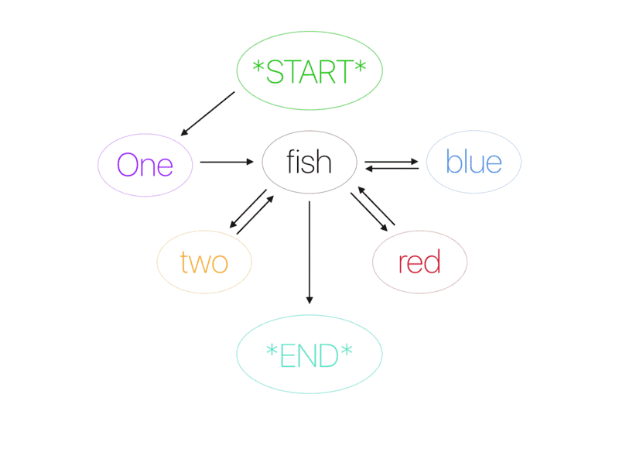
Natural language Generation Techniques
NLG techniques Example
1. Markov chain algorithm is used to predict the next word in the sentence by using the current word.
COM 316: Dr. T Njoroge
https://programmersought.com/article/28633109826/

Slide 20
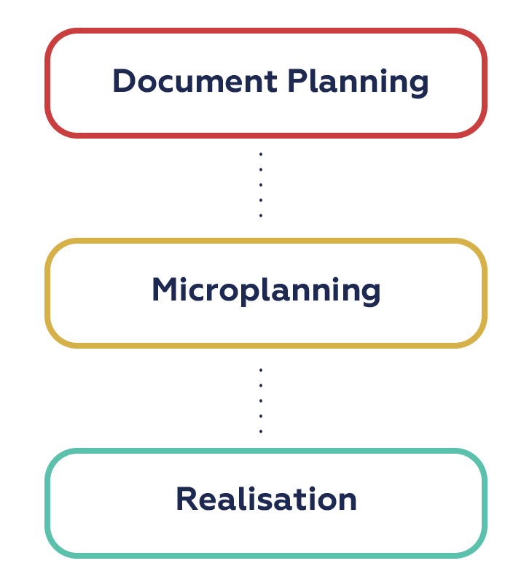
Stages of Natural Language Generation
https://www.kdnuggets.com/2020/01/guide-natural-language-generation.html
COM 316: Dr. T Njoroge
https://devopedia.org/natural-language-generation

Slide 21
1. Document Planning
Document Planning stage involves determine the information to be communicated and the Structure of such information.
General content is formulated and ordered in a logical manner.
It's also called Macro Planning or Content Determination and Text Planning:
Information could come from a knowledge base.
Selection of information must consider goals and preferences of both writer and reader.
COM 316: Dr. T Njoroge

Slide 22
2. Micro Planning
Micro planning stage is concerned with deciding how information must be split into sentences and paragraphs.
This stage considers punctuation and text flow, breaking out content into paragraphs and sentences and incorporating pronouns or conjunctions where appropriate.
That is, plan for a flowing narrative
Also called Sentence Planning
Techniques for this stage include:
  Referring expressions,
  Aggregation
  Lexicalization
  Grammaticalization.
COM 316: Dr. T Njoroge

Slide 23
3. Realization
Realization stage is concerned with converting the abstract document specifications to a real text,
It ensures individual sentences are generated in a grammatically correct manner. This involves syntax selection and inflection.
This stage accounts for grammatical accuracy, ensuring that rules around punctation and conjugations are followed.
For example, the past tense of the verb run is ran, not runned.
COM 316: Dr. T Njoroge

Slide 24
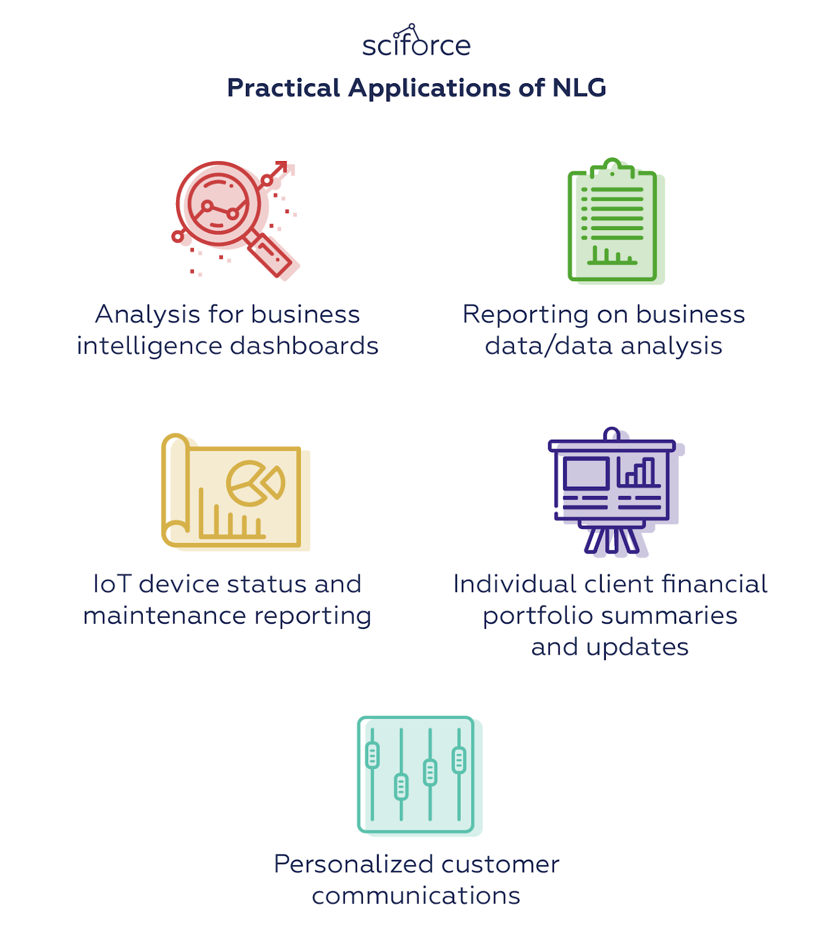
Applications of NLG
COM 316: Dr. T Njoroge

Slide 25
Applications of NLG
Other NLG Applications include:
Text Generation and Content Production
NLG systems can produce short-form, long-form, or summarized text.
Voice Assistants
Major voice assistants like Apple's Siri and Amazon's Alexa rely on NLG to answer your questions and queries.
Chatbots: Partially or fully generate natural language responses to use queries.
COM 316: Dr. T Njoroge

Slide 26
Components of NLP
Natural Language Understanding
COM 316: Dr. T Njoroge

Slide 27
Natural Language understanding
Natural Language understanding is concerned with learning or interpreting a language. That is, making sense of what is written or spoken.
Main focus of natural language understanding is to make machines:
  Interpret the natural language
  Derive meaning
  Identify context
  Draw insights
COM 316: Dr. T Njoroge

Slide 28
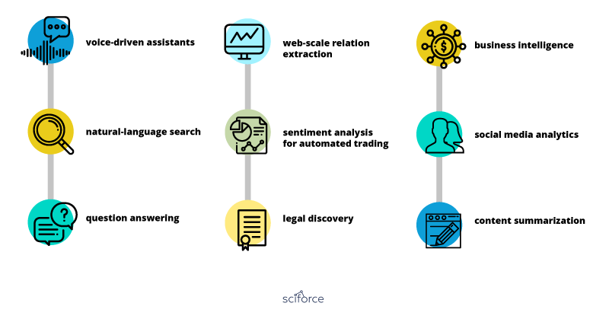
Natural language understanding Tasks
COM 316: Dr. T Njoroge

Slide 29
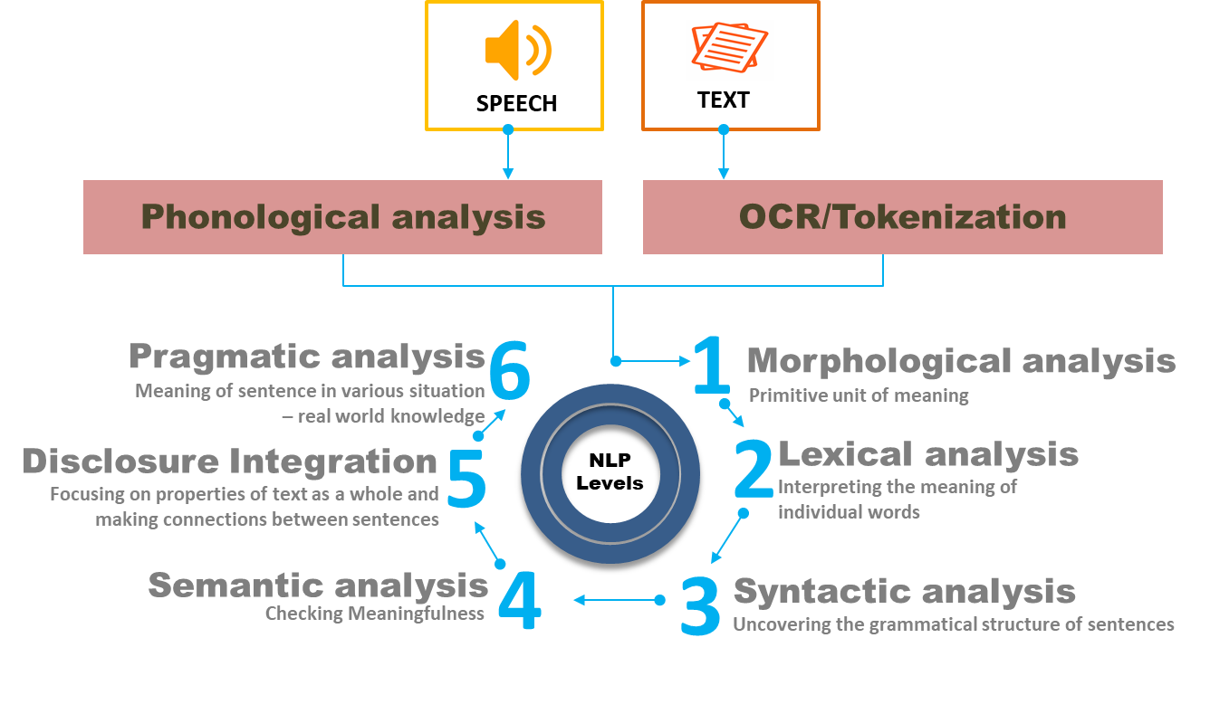
Natural Language understanding Techniques
NLU techniques include:
https://slidetodoc.com/natural-language-processing-lecture-1-mscomputer-science-semester/
COM 316: Dr. T Njoroge
https://www.tutorialspoint.com/artificial_intelligence/artificial_intelligence_natural_language_processing.htm

Slide 30
1. Syntactic Analysis
Syntactic Analysis aims at assessing whether or not the natural language aligns with grammatical or other logical rules
The syntax refers to the principles and rules that govern the sentence structure of any individual languages.
Syntax techniques include
  Lemmatization
  Stemming
  Parsing
  Word Segmentation
  Morphological segmentation
COM 316: Dr. T Njoroge

Slide 31
2. Semantic analysis
2. Semantic analysis is the process of assessing the meaning of text.
It allows computers to understand and interpret sentences, paragraphs, or whole documents, by analyzing their grammatical structure, and identifying relationships between individual words in a particular context.
Semantic analysis techniques include:
Entity Extraction - determining the parts of a text that can be identified and categorized into predefined
Word sense disambiguation: giving meaning to a word based on the context.
Machine Translation - automatically translate text from one human language to another e.g. from English to French.
COM 316: Dr. T Njoroge

Slide 32
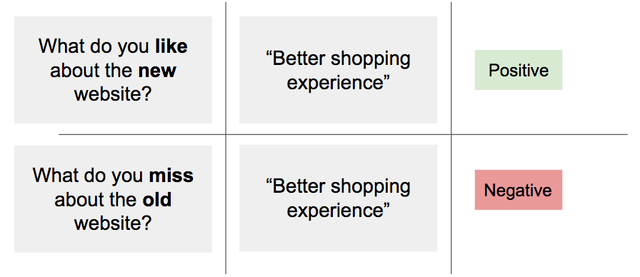
2. Sentiment Analysis
Sentiment analysis techniques detects and classifies subjectivity in text . Also known as or Opinion Mining (OM)
It involves examining if a given text is talking positively or negatively about a given subject (e.g. for brand monitoring purposes) or people’s opinions, attitudes and emotion s toward an entity.
The entity can represent individuals, events or topics, products, individuals, organizations, issues, topics events and their attributes
COM 316: Dr. T Njoroge

Slide 33
2. Sentiment Analysis
Types of sentiment analysis techniques
    1. Fine-Grained
    2. Aspect-Based
    3. Emotion Detection
    4. Intent Analysis
    5. Multilingual sentiment analysis
COM 316: Dr. T Njoroge

Slide 34
2. Sentiment Analysis
Sentiment analysis can be used for a number of business tasks:
Social media monitoring: analyze tweets and/or Facebook comments and detect if they are talking positively or negatively about a brand.
Tagging customer support tickets: analyze support tickets to quickly detect angry and frustrated customers.
Detecting customer pain points: analyze comments or survey responses to find if customers like or dislike particular aspects of a product or service.
Market research: analyze product reviews of a brand and its competition to find gaps in the market.
COM 316: Dr. T Njoroge

Slide 35
3. Lexical analysis
Lexical analysis is the process of analyzing the usage and the relationship of one word to others for the purpose of understanding the meaning of words.
Lexical analysis techniques aims at resolving Lexical ambiguity in text
Tokenization is the process of converting data into a sequence of tokens
Parts-of-speech tagging(Parsing) techniques identify each word in context and decide which part of speech it is
COM 316: Dr. T Njoroge

Slide 36
4. Discourse integration
Discourse integration is concerned with understanding the meaning of text by considering the context.
The context include next or previous sentence, paragraph, or document
It deals on how the immediately preceding sentence can affect the meaning and interpretation of the next sentence.
For example, In the sentence "He wanted that” the word "that" " depends upon the prior discourse context.
COM 316: Dr. T Njoroge

Slide 37
Pragmatic analysis
Pragmatics analysis techniques analyses how context contributes to meaning of a text.
They evaluate how human language is utilized in social interactions, as well as the relationship between the interpreter and the interpreted study language’s relation to contextual background.
It is as an approach focuses on language use, the intentions of writer/speaker and reader /hearer and mainly on contexts in the text. It goes beyond the structure of the language and operates with conversational rules that deal with the appropriate use of utterances.
COM 316: Dr. T Njoroge

Slide 38


Questions?
COM 316: Dr. T Njoroge

Slide 39
NLP Terminology
Text corpus or corpora
Token
N-Grams
Bag-of-words
Stop words
Lexicon
Lemma of a word
Inflection
Morphology
COM 316: Dr. T Njoroge

Slide 40
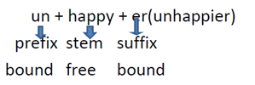
Morphology
Morphology the branch of linguistic that study structure(form) of words, how they are formed, and their relationship to other words in the same language
Words consists one or more elements known as Morphemes
For example, The word “unhappier” can be analyzed into 3 morphemes; “ un+ happy+er”
There are two Types
1. Free morphemes:- Basic word forms that can be used on their own
e.g., nouns, verb and adjectives.
2. Bound morphemes:-elements that cannot occur alone e.g. prefixes and suffixes
Example
COM 316: Dr. T Njoroge

Slide 41
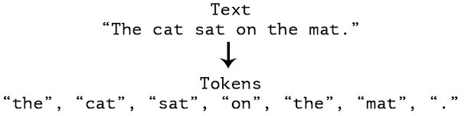
Token
Token - Each "entity" that is a part of whatever was split up based on rules.
For example, each word is a “token” when a sentence is "tokenized" into words.
Each sentence can also be a token, if you tokenized the sentences out of a paragraph.
Example
COM 316: Dr. T Njoroge

Slide 42
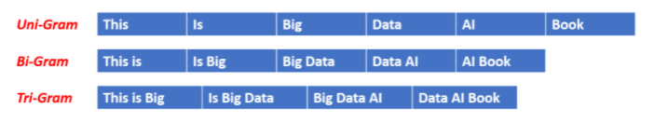
N-grams
An N-gram is a sequence of N words.
N is defined as an integer value starting from 1.
Types of N-Gram are:
Uni-Gram(N=1), Bi-Gram(N=2) , Tri-Gram(N=3) ..etc
Examples of N-Grams,
“Medium blog” is a 2-gram (a bigram),
“A Medium blog post” is a 4-gram,
“Write on Medium” is a 3-gram (trigram).
COM 316: Dr. T Njoroge

Slide 43
Stop Words
Stop words are the words in any language which does not add much meaning to a sentence.
stop words they are common words that have very little meaning or low analytic value.
Stop words are usually removed during preprocessing phase of text analytics process.
There is no universal list of stop words in nlp research, however the nltk module contains a list of stop words.
Examples of stop words:
  articles :- ‘a’, ‘an’, ‘the’, etc.
  conjunctions: ‘and’, ‘but’, etc,
  Qualifiers:- ‘yet’, ‘however’, etc.
COM 316: Dr. T Njoroge

Slide 44
Types of stop words
Types of stop words
Determiners – Determiners tend to mark nouns. They are usually will be followed by a noun examples: the, a, an, another
Coordinating conjunctions – Coordinating conjunctions connect words, phrases, and clauses examples: for, an, nor, but, or, yet, so
Prepositions – Prepositions express temporal or spatial relations
examples: in, under, towards, before
COM 316: Dr. T Njoroge

Slide 45
corpus
A corpus is a large set of text data that can be in one of the languages like English, French, and so on.
Corpora is the plural of corpus
The corpus can consist of a single document or a bunch of documents.
The source of the text corpus can be social network sites like Twitter, blog sites, open discussion forums like Stack Overflow, books, and several others.
In some of the NLP tasks like machine translation, require a multilingual corpus. For example we might need both the English and French translations of the same document content for developing a machine translation model. For speech tasks, we would also need human voice recordings and the corresponding transcribed corpus.
COM 316: Dr. T Njoroge

Slide 46

corpus
Sample corpus
Online sources of corpus
https://www.english-corpora.org/
https://www.languagesciences.cam.ac.uk/news/cambridge-english-corpus-available-academic-use
COM 316: Dr. T Njoroge

Slide 47
Lexicon
Lexicon - Words and their meanings.
Example: English dictionary.
Various fields will have different lexicons.
For example: To a financial investor, the first meaning for the word "Bull" is someone who is confident about the market, as compared to the common English lexicon, where the first meaning for the word "Bull" is an animal.
COM 316: Dr. T Njoroge

Slide 48
Inflection
Inflection is the grammatical term for letters added to nouns, adjectives, and verbs to show their different grammatical forms.
It is the change of form a noun, adjective, verb, etc., undergoes to distinguish its case, gender, mood, number, voice, etc.
Inflection occurs when the word is used to express various meanings.
Example
Base Word | Inflection
fox | foxes
run | Running
Goat | Goats
COM 316: Dr. T Njoroge

Slide 49
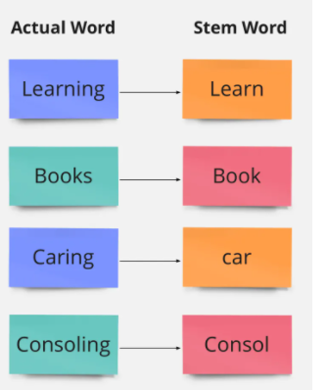
Stem
Stem is the root of word.
It is the basic form of a word
Examples:
‘mining’ can be reduced into ‘mine’.
‘foxes’ can be reduced to ‘fox’
‘running’ can be reduced to ‘run’
COM 316: Dr. T Njoroge

Slide 50
Lemma of word
lemma is the form of a word under which it is registered in a dictionary. A lemma is, so to speak, the keyword in the respective reference work.
This is helpful because not all possible word forms of a word get their own entry in a lexicon.
For example, run, runs, running and ran are forms of one and the same basic form: run; run is the lemma.
COM 316: Dr. T Njoroge

Slide 51
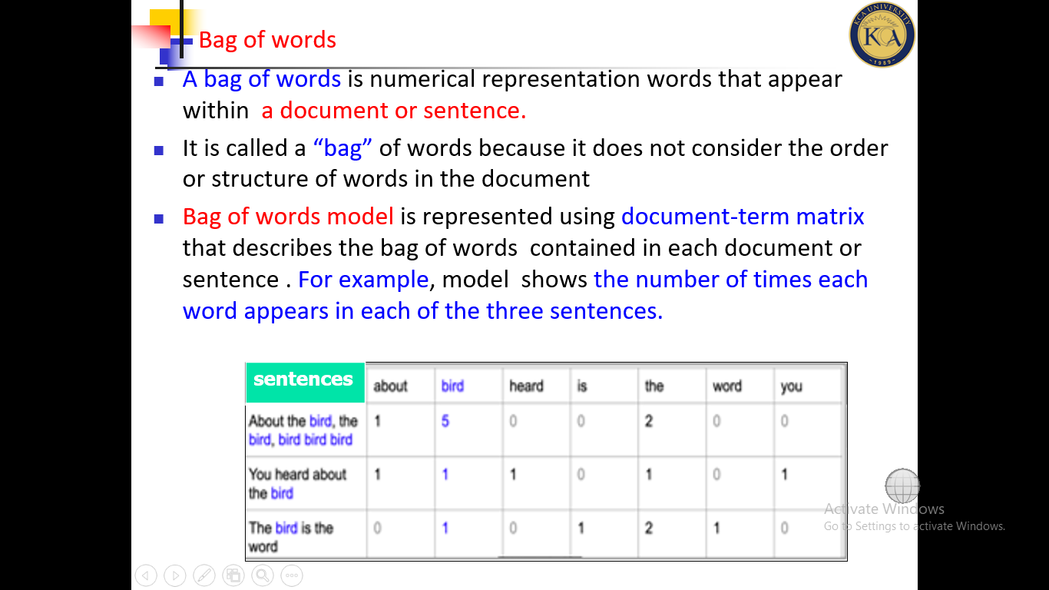
Bag of words
A bag of words is numerical representation words that appear within a document or sentence.
It is called a “bag” of words because it does not consider the order or structure of words in the document
Bag of words model is represented using document-term matrix that describes the bag of words contained in each document or sentence . For example, this model shows the number of times each word appears in each of the three sentences.
COM 316: Dr. T Njoroge

Slide 52
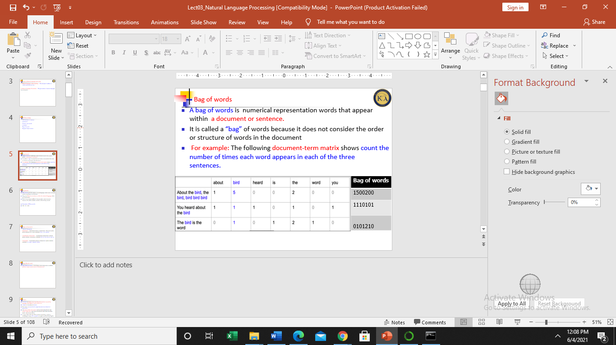
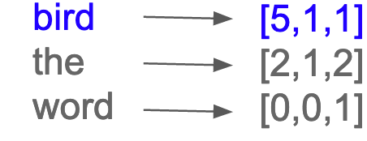
Bag of words
Example
Each row corresponds to one of the sentences, and each column to a word in the corpus. For instance, bird appears 5 times in sentence1 and once(1) in sentences2 and 3 respectively.
In a bag of words, each word has its own numeric vector
Example:
COM 316: Dr. T Njoroge

Slide 53
Text Preprocessing techniques
Text Preprocessing techniques are used to prepare text for data analytics/Mining tasks.
They are used to make raw data more valuable for building natural language models.
Types of Preprocessing techniques :
  Extracting top keywords Lowercasing
  Stemming Lemmatization
  Stopword Removal Normalization
  Noise Removal Text Enrichment / Augmentation (e.g.POS)
COM 316: Dr. T Njoroge
https://dataaspirant.com/nlp-text-preprocessing-techniques-implementation-python/#t-1600076346678

Slide 54
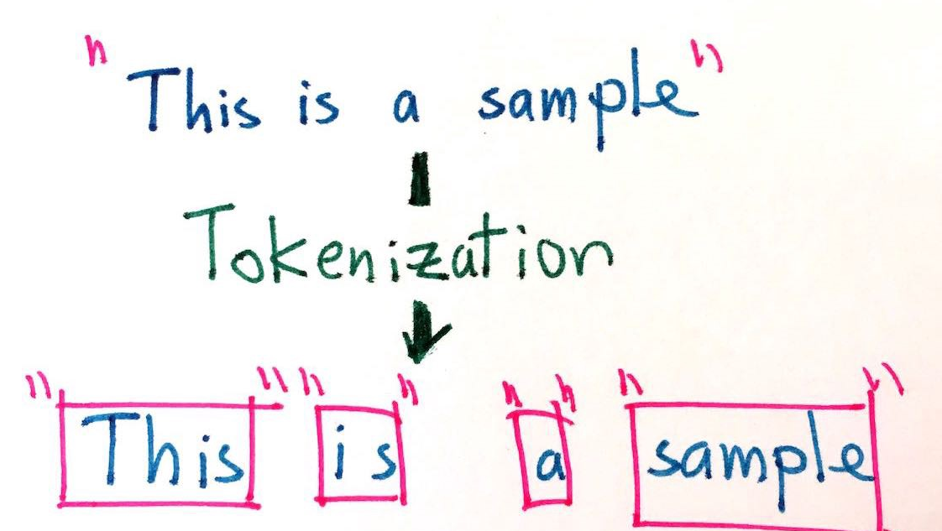
Tokenization
Tokenization is the process by which a large quantity of text is divided into smaller parts called tokens.
These tokens are very useful for finding patterns and are considered as a base step for stemming and lemmatization.
Tokenization also helps to substitute sensitive data elements with non-sensitive data elements.
There two types of tokenization:
1. Tokenization of words
2. Tokenization of Sentences
COM 316: Dr. T Njoroge

Slide 55
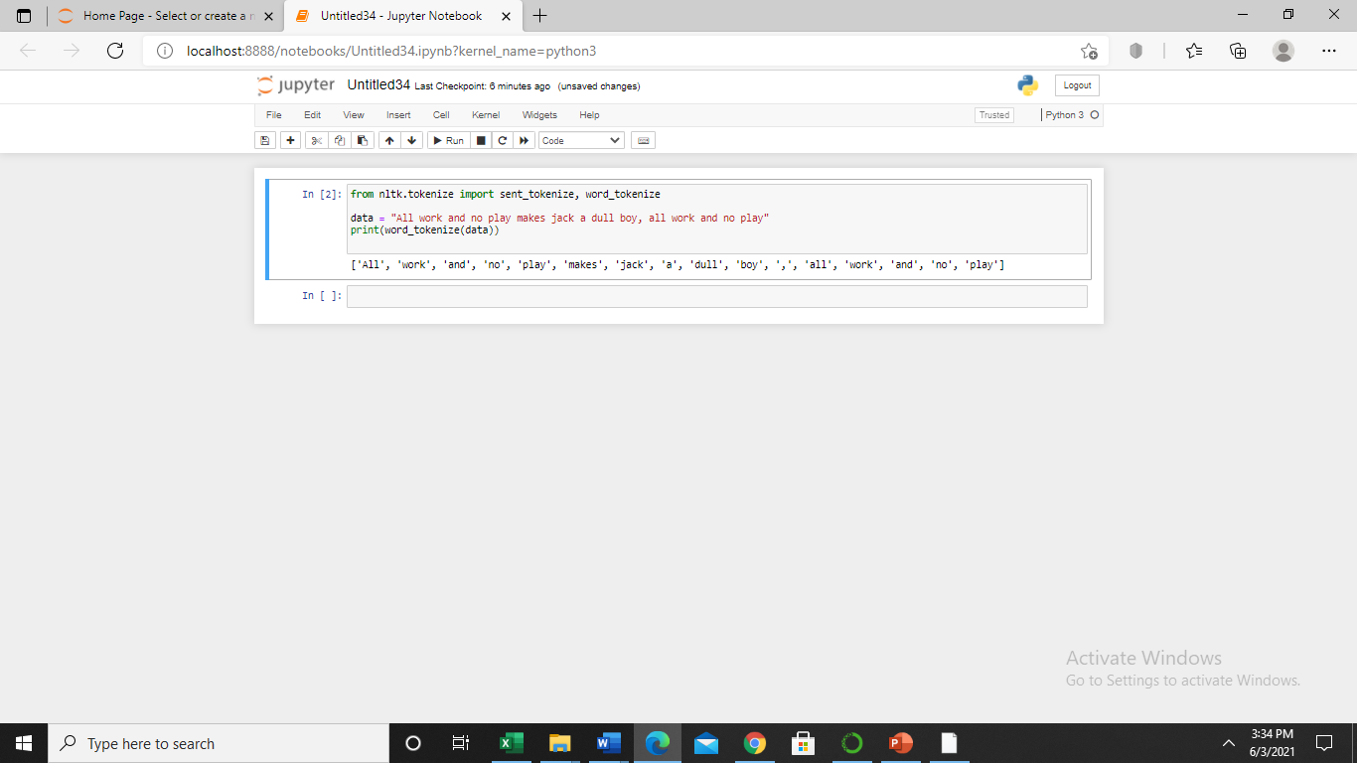
Types of Tokenization
1. Tokenization of words is the process of splitting a sentence into words.
The output of word tokenization can be provided as input for further text cleaning steps such as punctuation removal, numeric character removal or stemming
In python, word_tokenize() function is used to split a sentence into words
Sample code and output
COM 316: Dr. T Njoroge
Python Tutorial url: https://pythonspot.com/tokenizing-words-and-sentences-with-nltk/

Slide 56
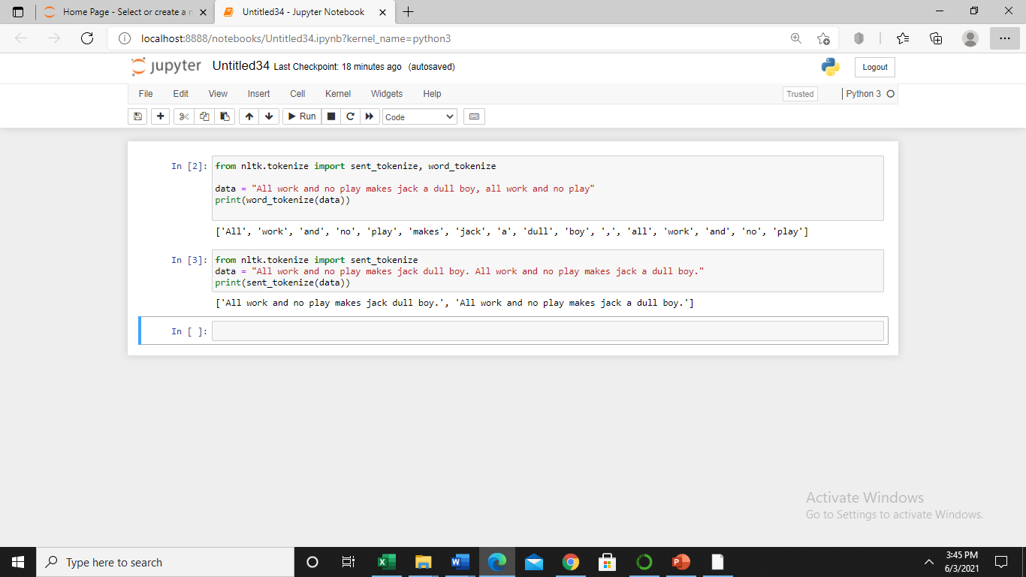
Types of Tokenization
2. Sentence tokenization is the process of splitting text into individual sentences.
sent_tokenize() function is used to perform this process
Sample code and output
The above code splits data into two sentences
COM 316: Dr. T Njoroge

Slide 57
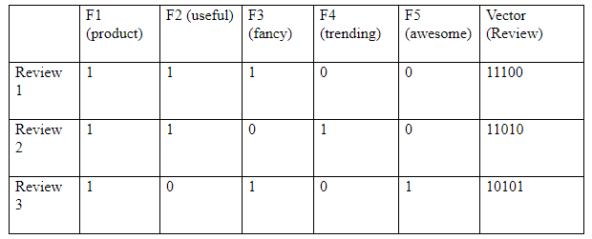
Creating Bag of words model
Bag of words gives the insight that similar documents or sentences will have word counts similar to each other. Much precisely, more similar words in two documents will tend to be more similar in the documents.
Example: In the following document-term matrix, 1 denotes the presence of a word in the sentence review and 0 denotes its absence.
It can be concluded that three reviews are similar in terms of “product”
COM 316: Dr. T Njoroge

Slide 58
Creating Bag of words model
The steps involved in creating the bag of Words (BOW) model for a piece of text are as follows:
Tokenize the text and store the tokens in a list.
Create a vocabulary out of the tokens.
Count the number of occurrences of tokens in each sentence and store the count.
Create a bag of words model by converting the text into vectors with count of each word from the vocabulary.
COM 316: Dr. T Njoroge

Slide 59
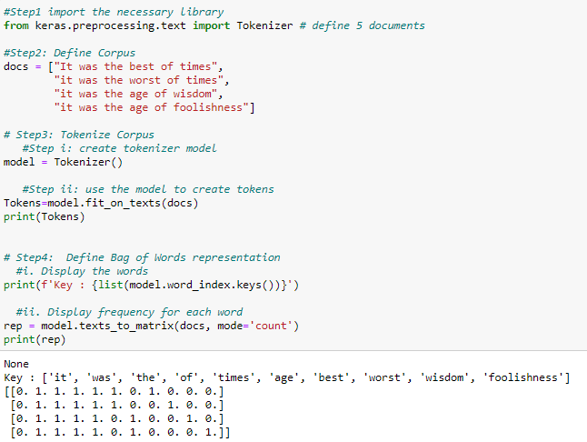
Creating Bag of words model
Sample code and output
COM 316: Dr. T Njoroge
https://www.journaldev.com/46591/bag-of-words-model-in-python

Slide 60
Stemming
Stemming is a technique of extracting the base form (root) of the words by removing prefixes and suffixes from them without consider the use or context of the
It is just like cutting down the branches of a tree to its stems.
For example, the stem of the words eating, eats, eaten is “eat”.
Search engines use stemming for indexing the words.
That’s why rather than storing all forms of a word, a search engine can store only the stems. In this way, stemming reduces the size of the index and increases retrieval accuracy.
Example
word | stemmed word
chocolates | chocolate
Chocolatey | chocolate
Retrieves | Retrieve
COM 316: Dr. T Njoroge

Slide 61
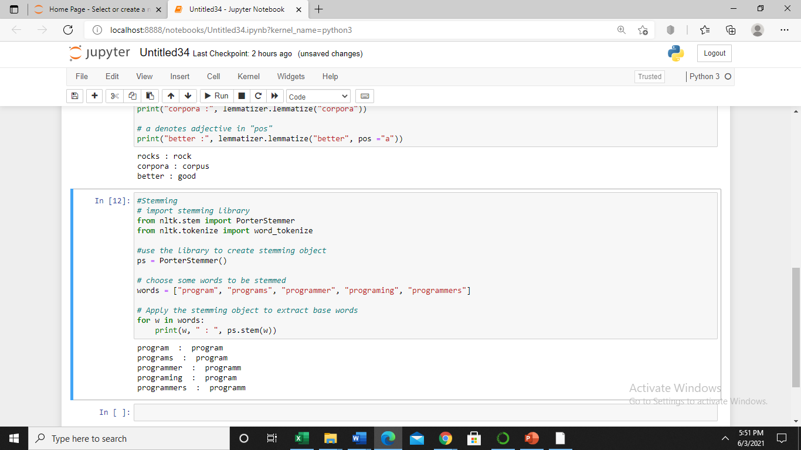
Stemming
Sample code and output
COM 316: Dr. T Njoroge

Slide 62
Lemmatization
Lemmatization is the algorithmic process of finding the lemma of a word depending on its meaning and context.
It involves grouping together the different inflected forms of a word so they can be analyzed as a single item.
Lemmatization is similar to stemming but it brings context to the words. So it links words with similar meaning to one word.
Lemmatization usually refers to the morphological analysis of words, which aims to remove inflectional endings.
It helps in returning the base or dictionary form of a word known as the lemma.
Examples of lemmatization:
-> rocks : rock
-> corpora : corpus
-> better : good
COM 316: Dr. T Njoroge
The output of lemmatization is ‘lemma’(dictionary form of a word).

Slide 63
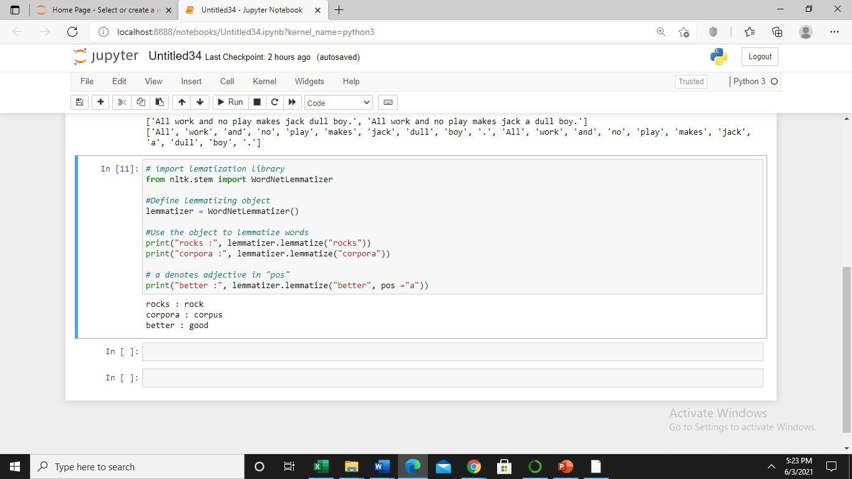
Lemmatization
Sample code and output
COM 316: Dr. T Njoroge

Slide 64
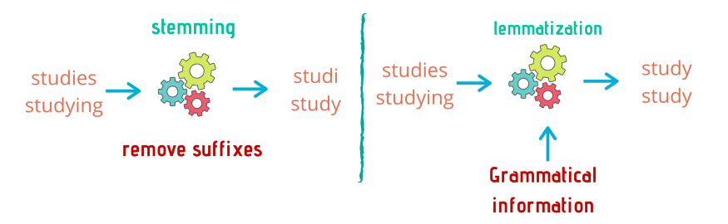
Stemming Versus Lemmatization
Stemming | Lemmatization
only common prefixes and suffixes of the language are analyzed. It does not require dictionary of the language. | Often require a dictionary of the language to be able to categorize each word correctly.
Example
COM 316: Dr. T Njoroge
Unlike stemming, Lemmatization always extracts a valid word

Slide 65
Questions?

